Slide 1
MISSION FOR ALL (MIFA)
TODAY

Slide 2
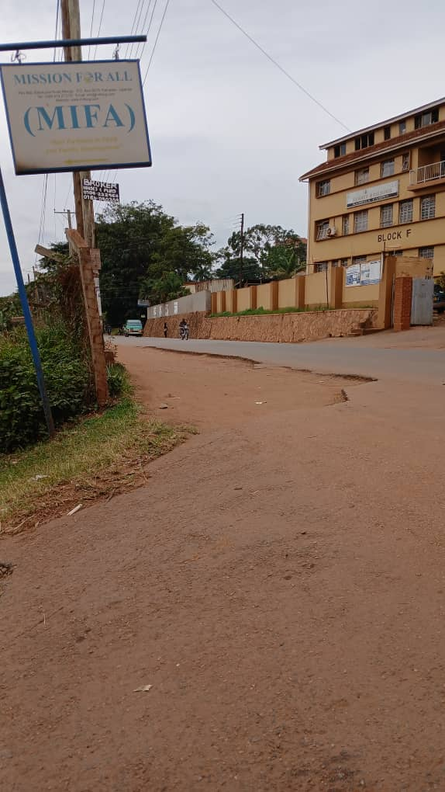
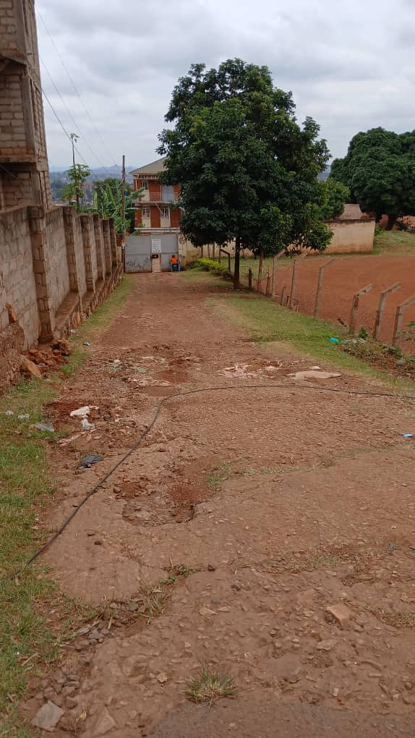
WELCOME TO MIFA
Branching to MIFA from Mengo Hospital. The storied building is no longer UPMB; it now houses the Senate building of Ndejje University.
Sloping down to the gate is still having gullies. Walk slowly and carefully.

Slide 3
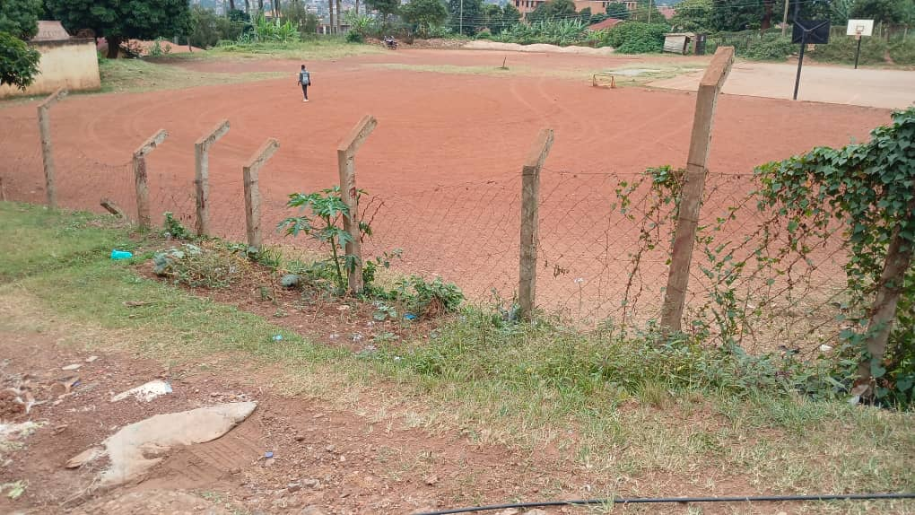
DOWN TO THE GATE
On your right is now the Ndejje University play ground. It is isolated in the morning hours.

Slide 4
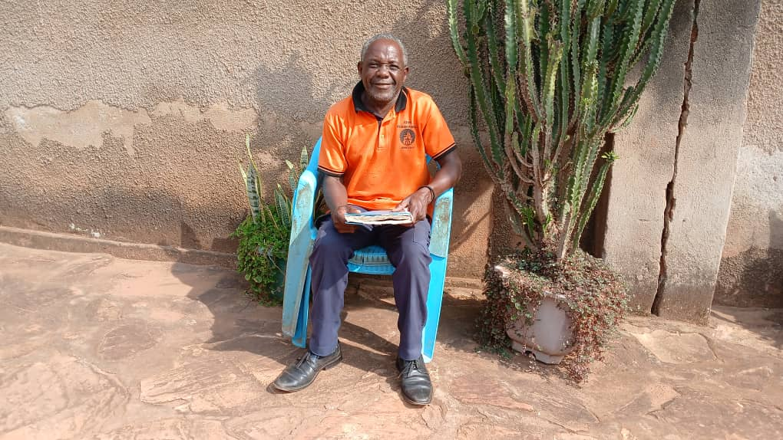
Security Check Point with John

Slide 5
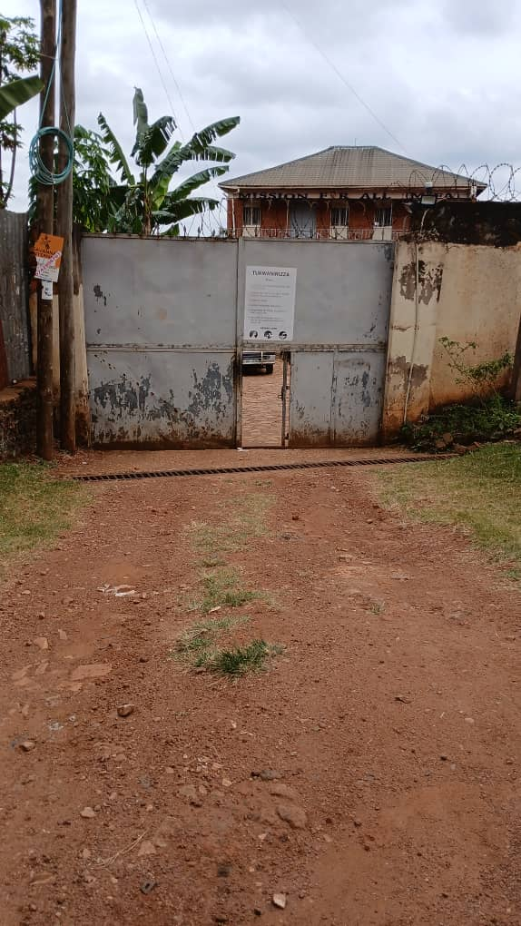
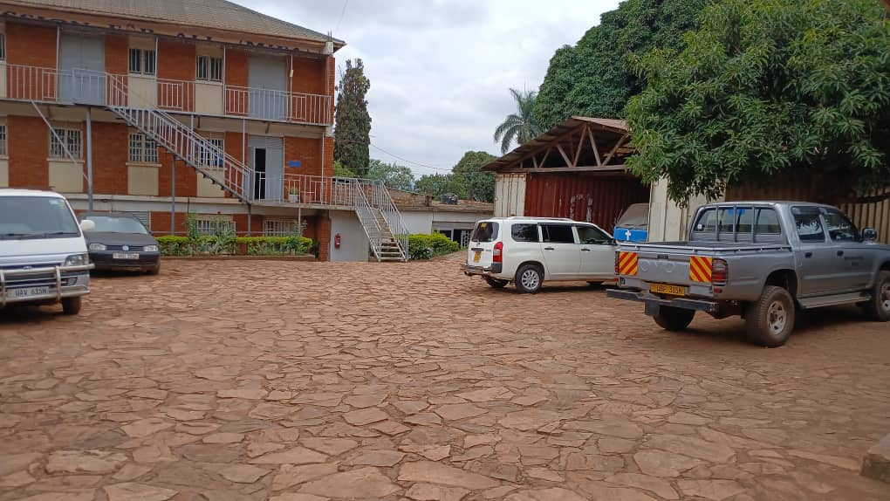
At the gate, remember to bend; otherwise you cannot enter. Read the COVID care instructions. But you should know Luganda.
The MIFA compound also serves as the Parking lot for our visitors and our tenants.

Slide 6
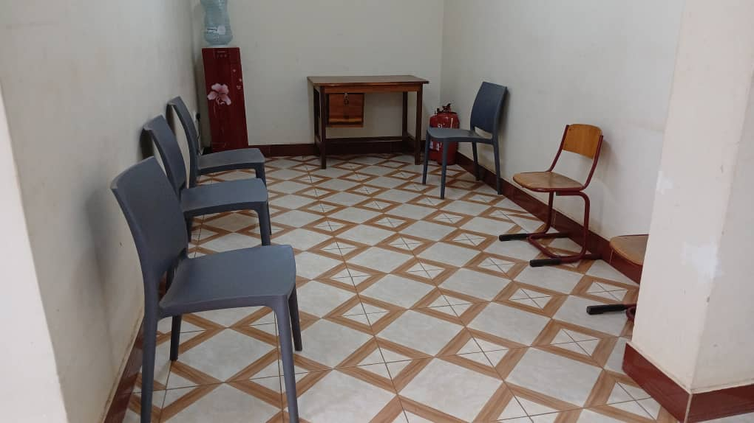
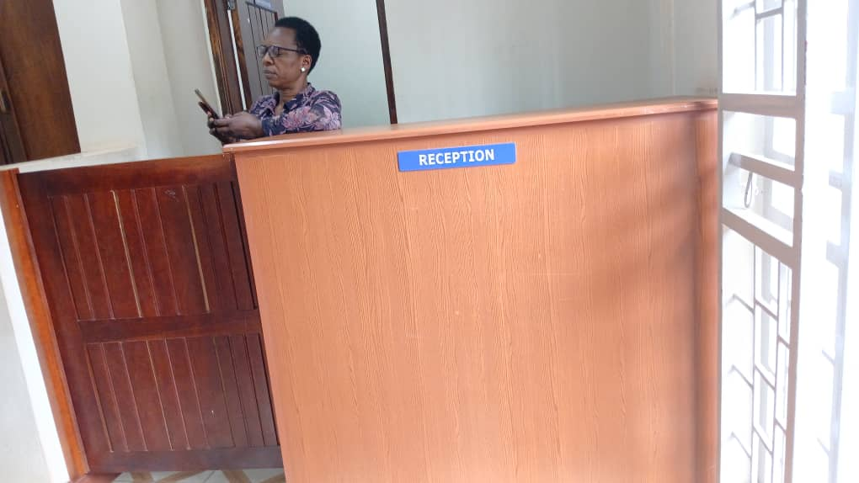
INSIDE THE OFFICE
Please go the Reception desk. Racheal will come over quickly to attend to you.
Then, keep waiting for additional help in the Waiting room. Feeling thirsty? You are free to take a glass of water.

Slide 7
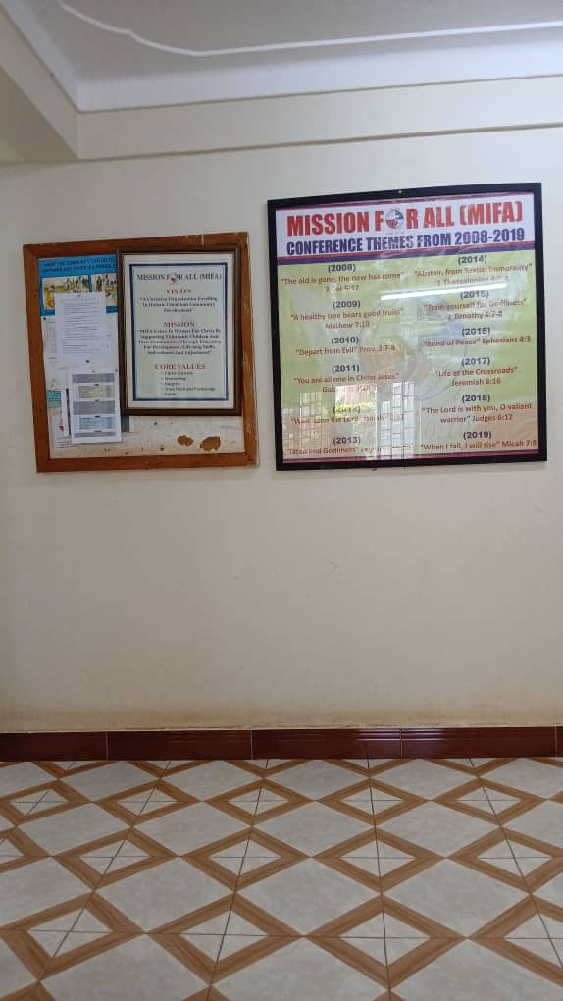
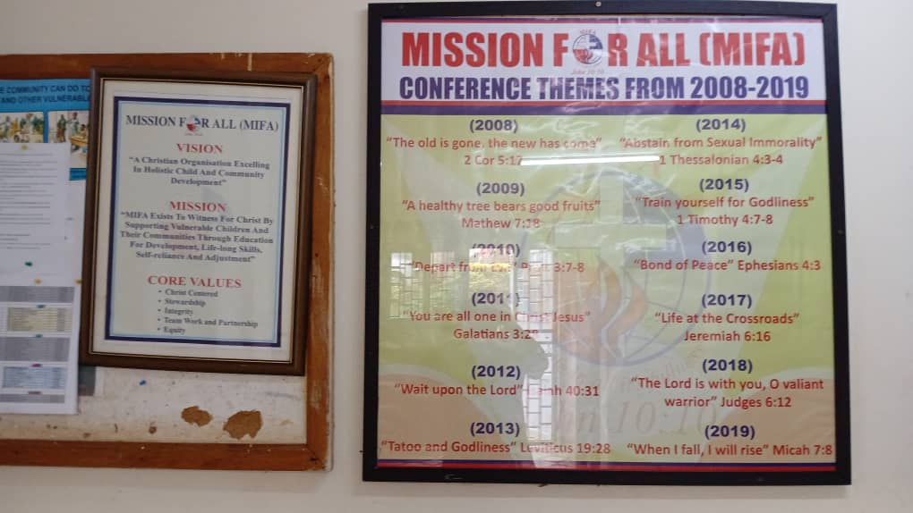
You are free to take a look at the General Notice Board. Read the Conference themes; MIFA Vision, Prayer Rota, etc.

Slide 8
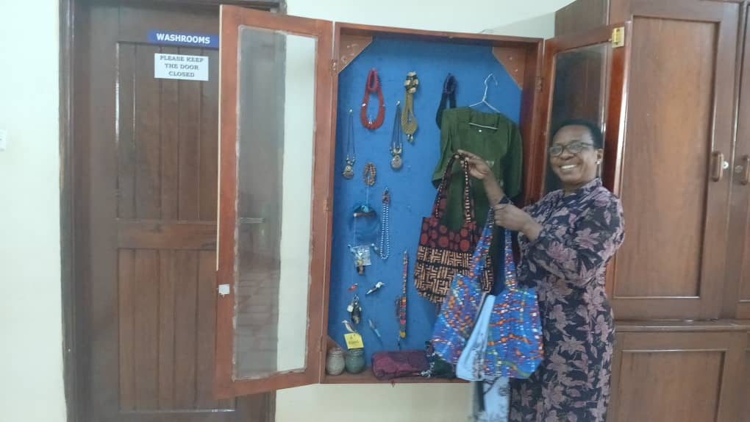
Racheal can show you what to buy from the MBAPA Women’s beautiful crafts collections.

Slide 9
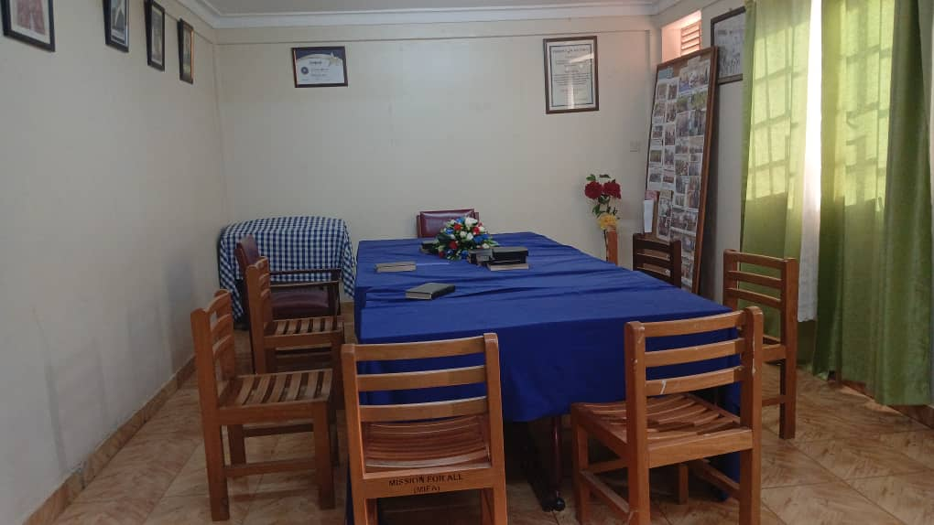
There is no Board meeting today. If there was, you would see them seated here. On Monday and Wednesday morning, this place is the Prayer Altar.

Slide 10
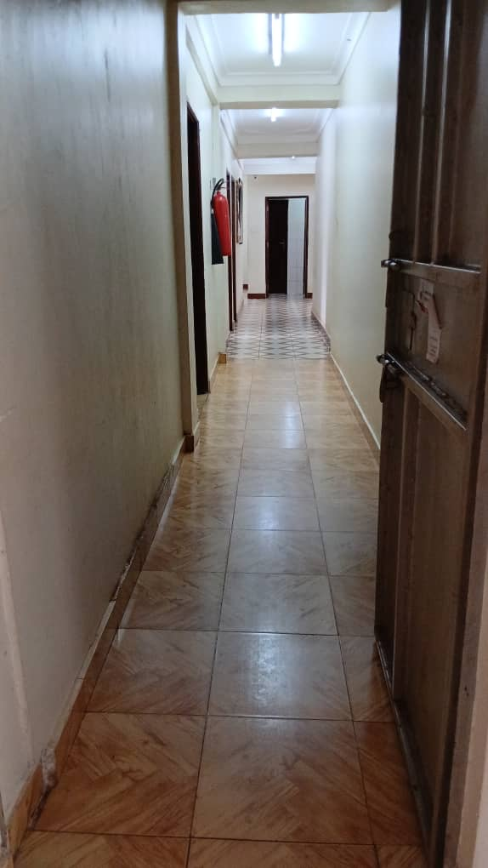
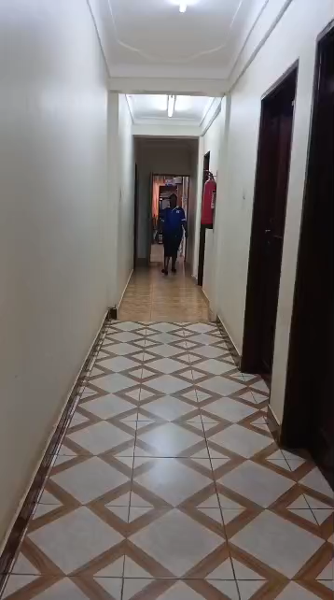
The new Corridor connects the Administration to the Sponsorship Offices. Let us go.

Slide 11
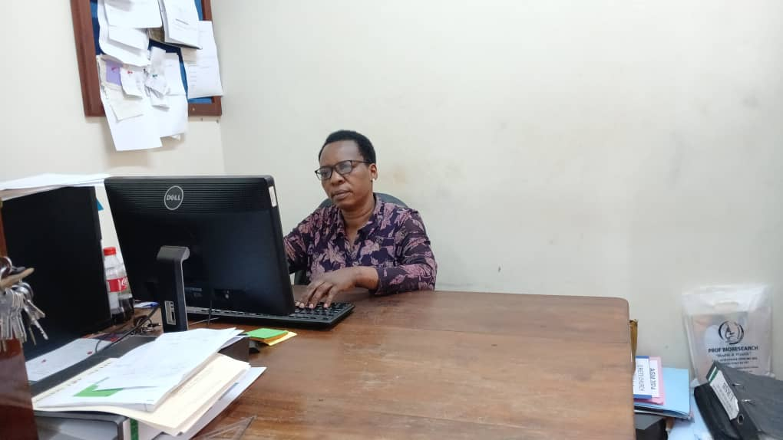
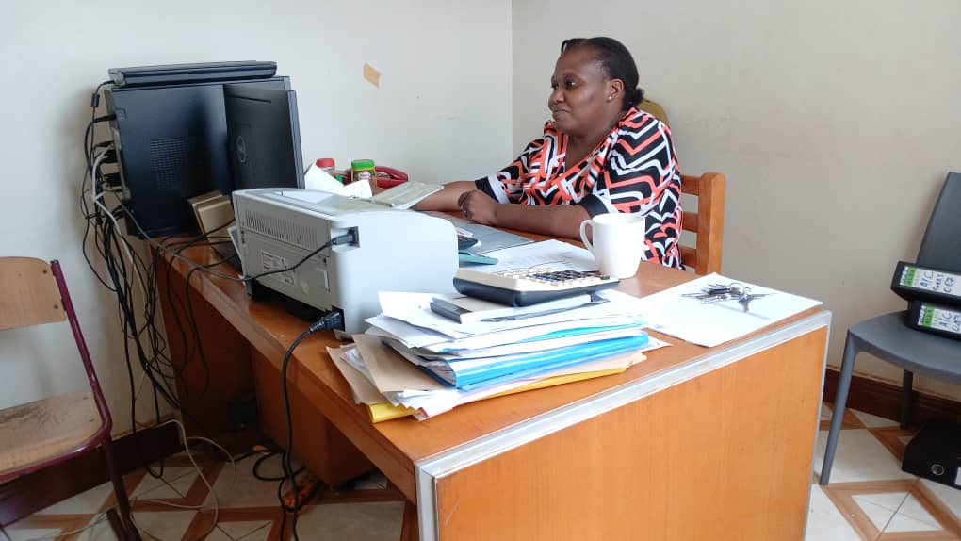
WHO IS WHO?
Racheal the Administration and Human Resource Officer.
Becky, the Accountant; expert of figures.

Slide 12
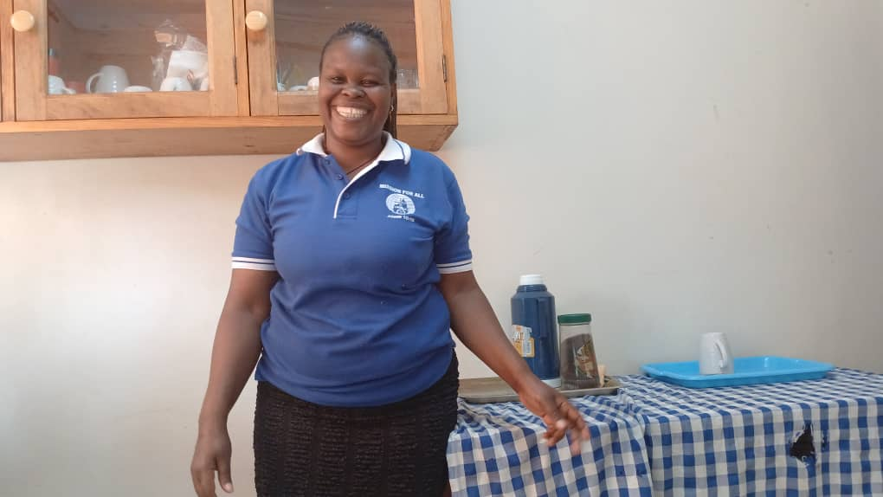
Josephine, our Office Messenger will prepare for you a hot cup of tea, if you like it.

Slide 13
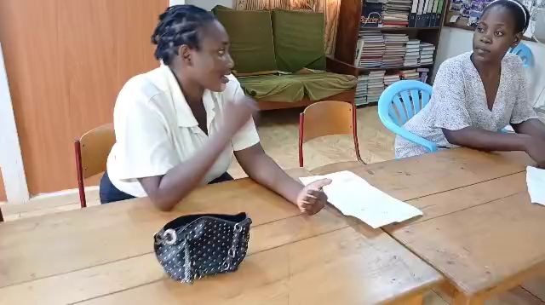
Have you seen the Sponsorship business? Maria is having a serious meeting with sponsored child and her guardian. Sponsored children and their families sit here and write letters and share stories with each other.

Slide 14
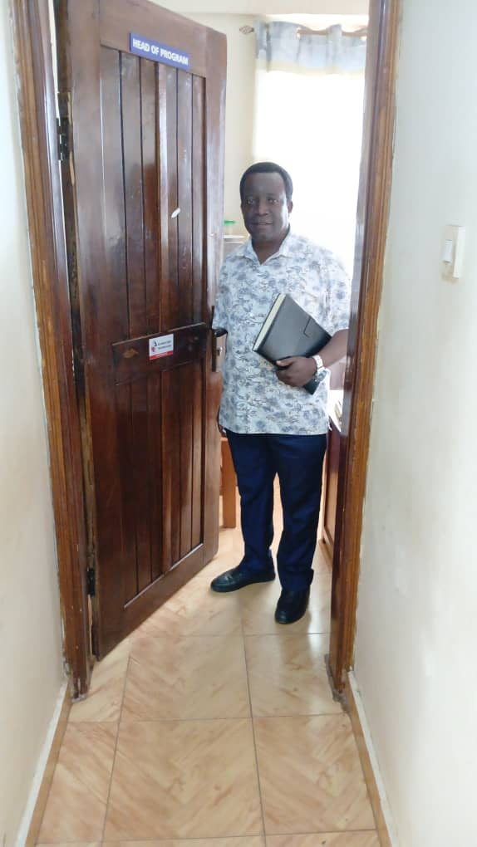
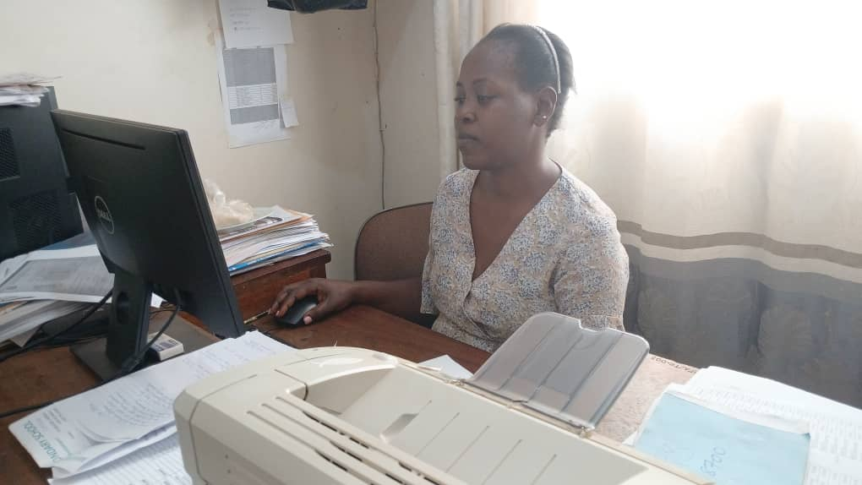
Noah, the Sponsorship Manager
Maria, the Sponsorship Officer

Slide 15
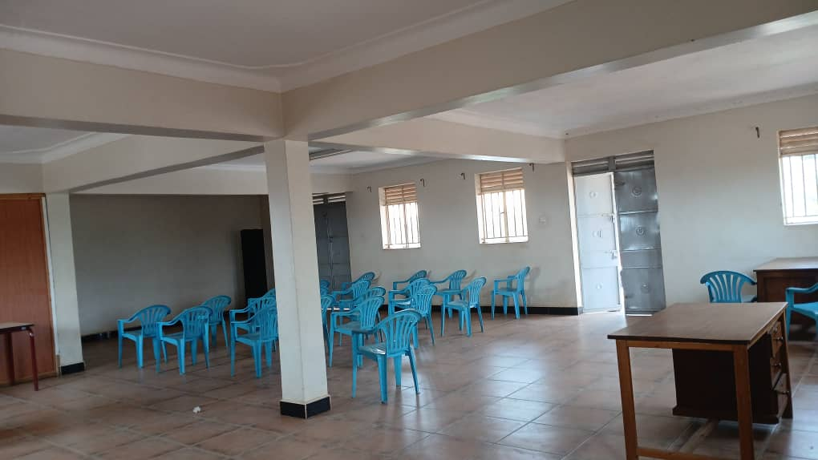
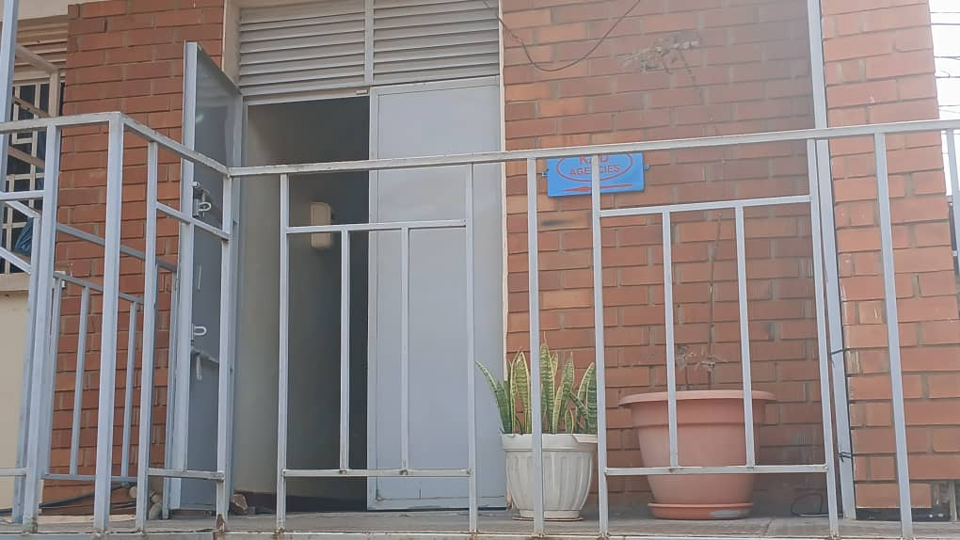
Development at MIFA
Upper Hall available for hire
First floor rented out to KAD Agencies

Slide 16
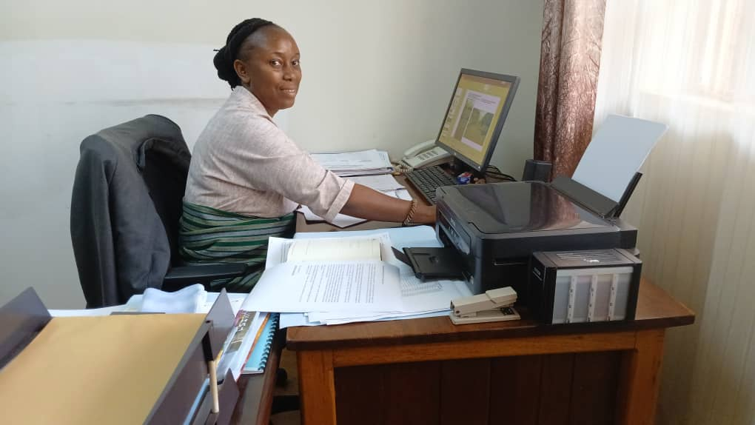
The Executive Director, Sylvia, welcomes every one

Slide 17
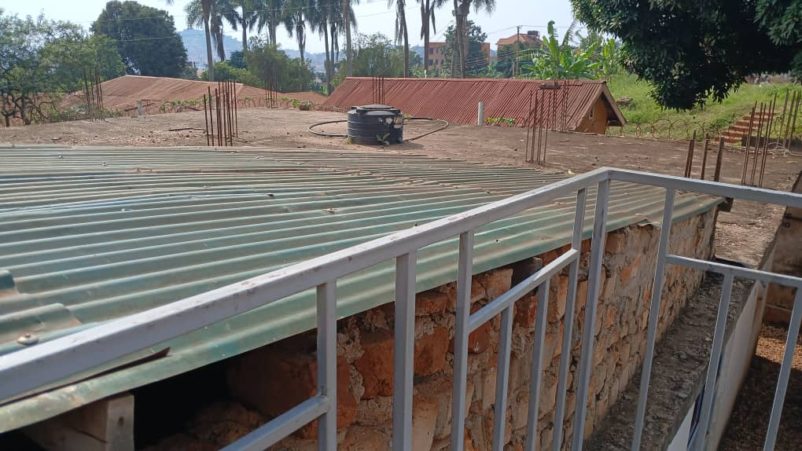
Phase 2 of the MIFA Building needs some Millions

Slide 18
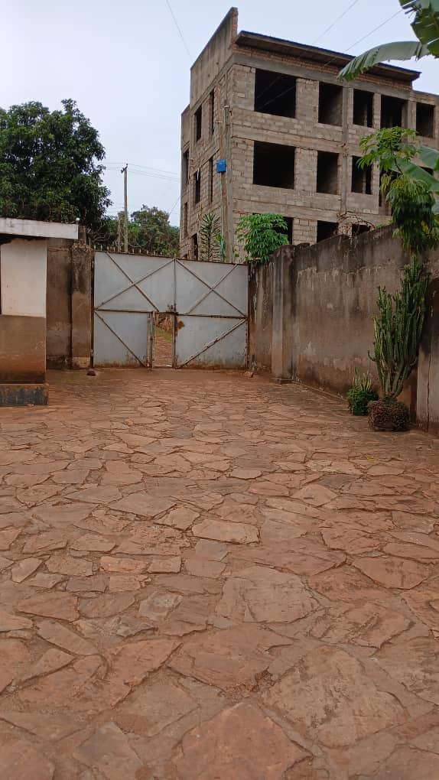
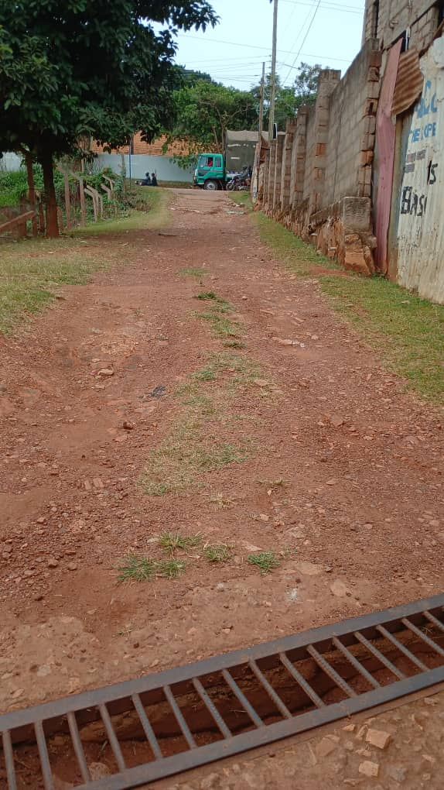
Ready to leave MIFA back to the Hotel?
The exit gate is here.
The main road is now visible. Mind the traffic on this road.

Slide 19
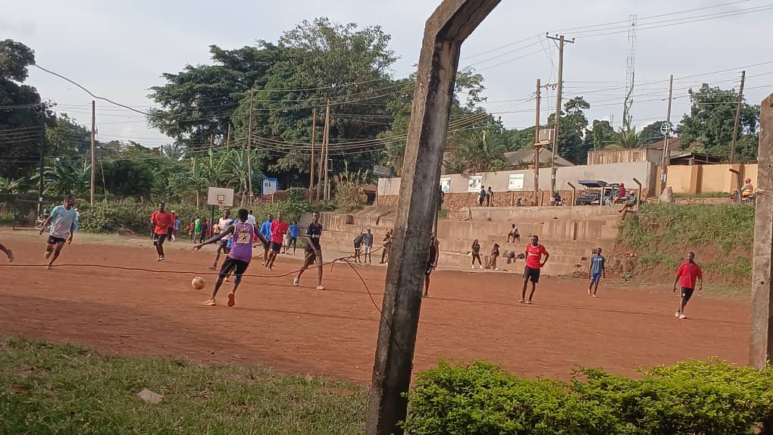
As you leave, take some minutes to watch these young boys playing football. But don’t take too long. Remember to go back home early. It is a dangerous road after 8pm.

